Slide 1
GAS BOOKING
Here is where our presentation begins...

Slide 2
TEAM MEMBERS
2203A52L02 - M.PRANAVI
2203A52L03 - K.VASANTH
2203A52L04 - K.ACHYUTH
2203A52L05 - N.SANJAY

Slide 3
TABLE OF CONTENTS
01
03
02
04
Introduction
Assignment
Features of the topic
About the Topic

Slide 4

INTRODUCTION
This project is a Gas connection system written in the C language that uses a double linked list. The system allows users to new connection enrollment, terminate current connection, book a cylinder, employee, feedback, and exit . It also includes features such as alphabetically and displaying the number of contacts stored in the directory. All data is stored in a linked list, which makes the system fast and efficient. The user interface is designed to be straightforward and intuitive. The code is modular, well-documented, and designed to be easily extensible. This project is an ideal starting point for any application that requires a gas booking system. This project is an implementation of a gas booking system using the C programming language and a double linked list data structure. It provides the user with an efficient way to store, search, and modify contact information. The program has functions to add, delete, and modify contacts, as well as to search for contacts by name or phone number. It also has a utility to display all contacts in the connection enrollment. The double linked list data structure enables efficient searching and modification of contact information, and booking, delete current connection while providing a compact memory footprint. The program is written in C and is well documented, making it easy to modify and extend.

Slide 5
Problem statement
Design a C language program using a single linked list to create and book a cylinder. A gas booking system should give new connection enrollment. The program should allow a user to new connection enrollment, terminate current connection, book a cylinder, feedback. The program should also be able to print out the entire gas booking system.

Slide 6
Existing solution
Existing solution is where user need to call the call centre and book the gas cylinders which we can be overcome by using our application . Our application provides a user friendly interface which can be understand to every person.

Slide 7
Proposed solution
___
Our team is here to propose an solution to the existing method which overcomes the difficulties while booking a cylinder which is very normal thing in our daily life. Our solution is to create a user friendly application which can be usable by any age group of person, using double linked list (data structures ) in c language.

Slide 8
Modules based on:
Creation of connnection
Termination of connection
Book a cylinder
Employee
Feedback
Exit
Based on creation of node in double linked list
Based on deletion of node in doubly linked list
Based on insertion of data to a node
Based on display the specific node data
Based on entering data to a node
Exit the programme

Slide 9
MODULES
New connection enrolment
Terminate the connection
Employee
Feedback
To create a new connection
To delete an existing connection
To view feedback and connections to particular employee
To give feedback to the company

Slide 10

REQUIREMENTS
1. Operating System: The system requires a computer with a modern operating system such as Windows, Mac OS, or Linux.
2. Programming Language: The system should be written in C language.
3. Data Structures: The system should use Double linked list to store the data.
4. User Interface: The system should provide a user-friendly interface to allow the user to view, add, delete, and modify entries in the to fill the details.
5. Memory: The system should be able to store at least 5000 entries in the directory.
6. Input: The system should accept user input from the keyboard.
7. Output: The system should be able to display the Gas booking system in a readable format.
8. Documentation: The system should be properly documented.

Slide 11
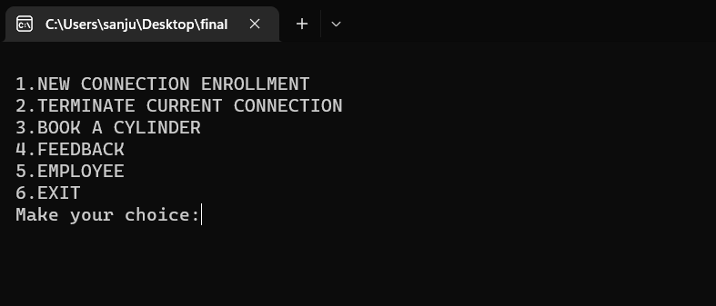
OUTPUTS

Slide 12
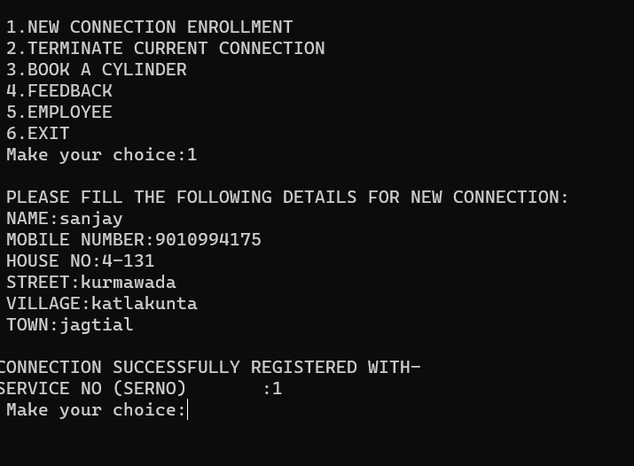

Slide 13
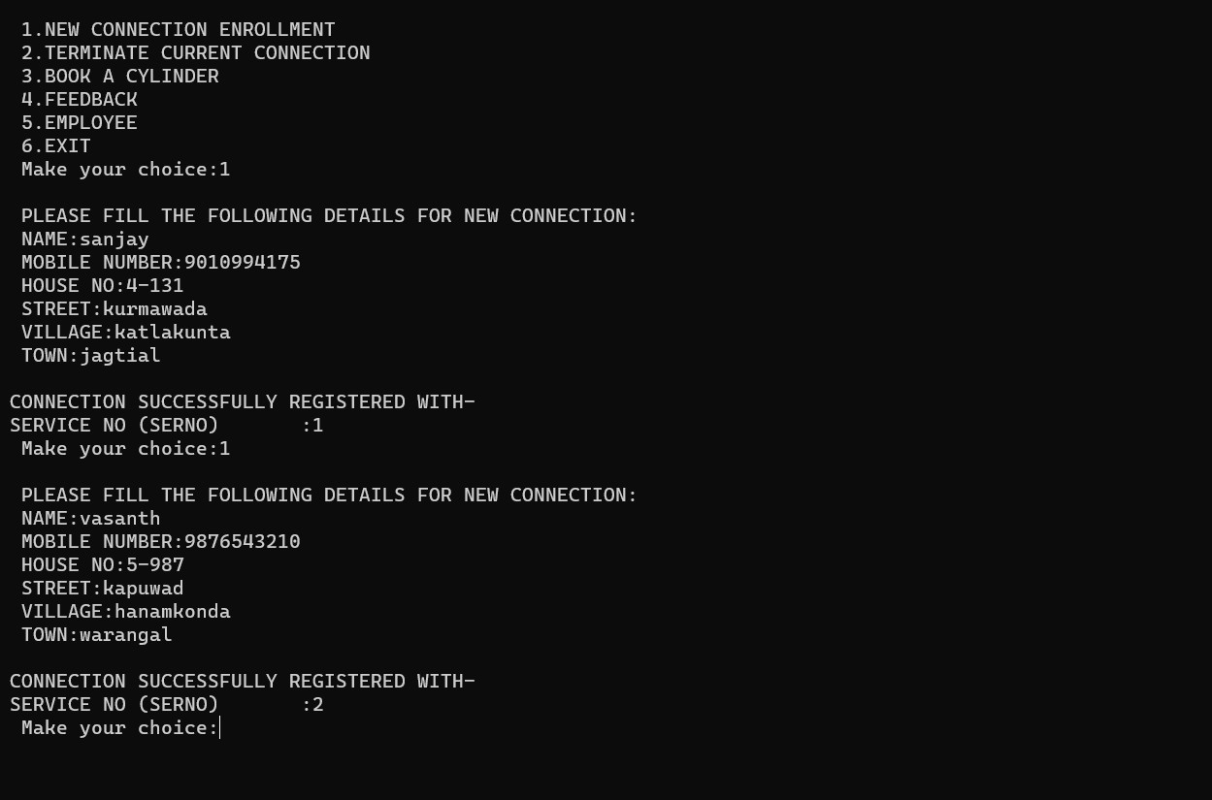

Slide 14
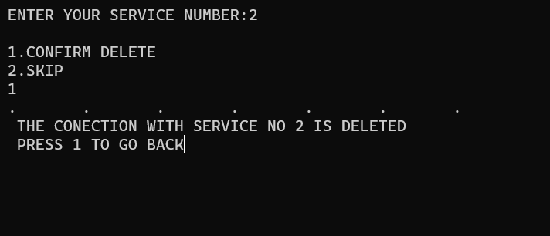

Slide 15
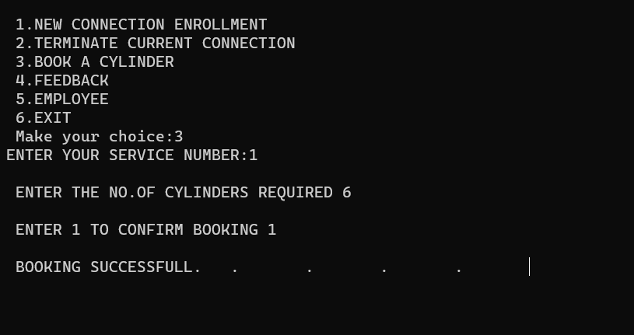

Slide 16
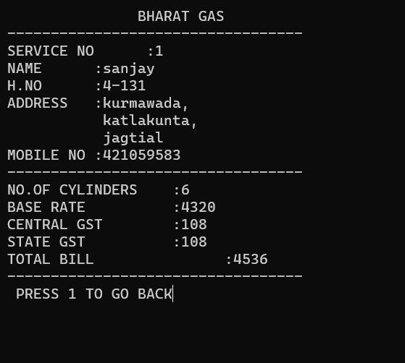

Slide 17
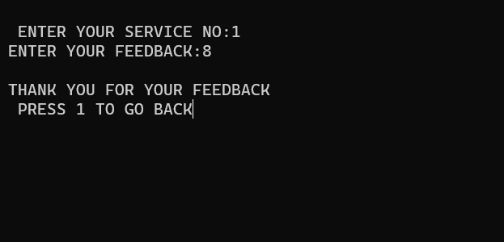

Slide 18
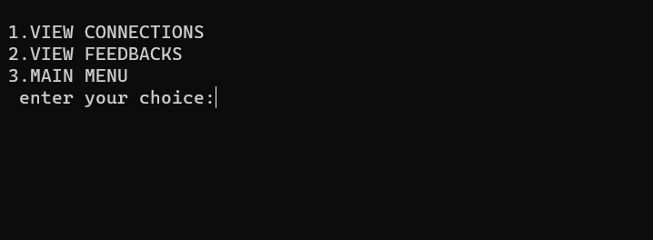

Slide 19
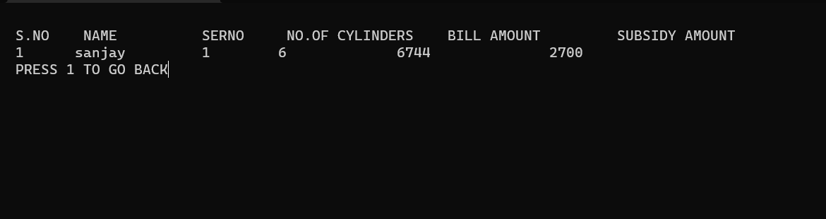

Slide 20
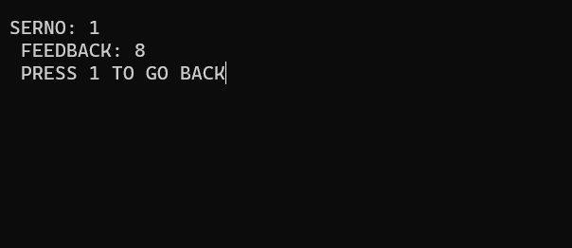

Slide 21
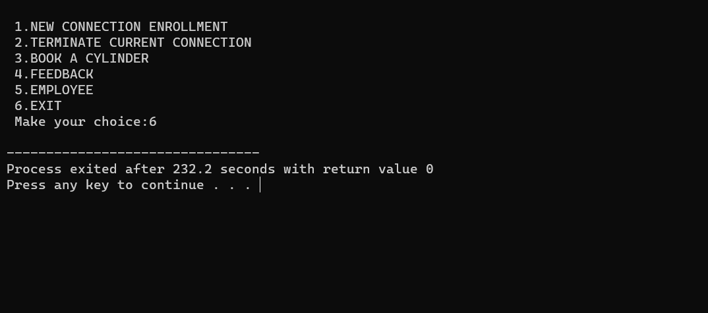

Slide 22
Conclusion
In conclusion, The GAS BOOKING using a Double linked list in C language is a great data structure for storing of contact information deletion,feedback,and for booking. It allows for fast search times and the ability to store and update contact information quickly. Additionally, the linked list structure allows for easy management of large databases of contacts. The GAS BOOKING implemented using a Double linked list in C language has proved to be an efficient and effective way to store and access contact information. This automated system has the advantage of maintaining the records properly without any manual stress. The program is able to successfully add, delete, booking and feedback for a new connection. It is able to handle large amounts of data efficiently. The double linked list structure is an efficient data structure and has made the program run faster. Hence it becomes easier for the user to automate the property auctioned .it has been proved to be a useful tool for managing contact information.

